Slide 1
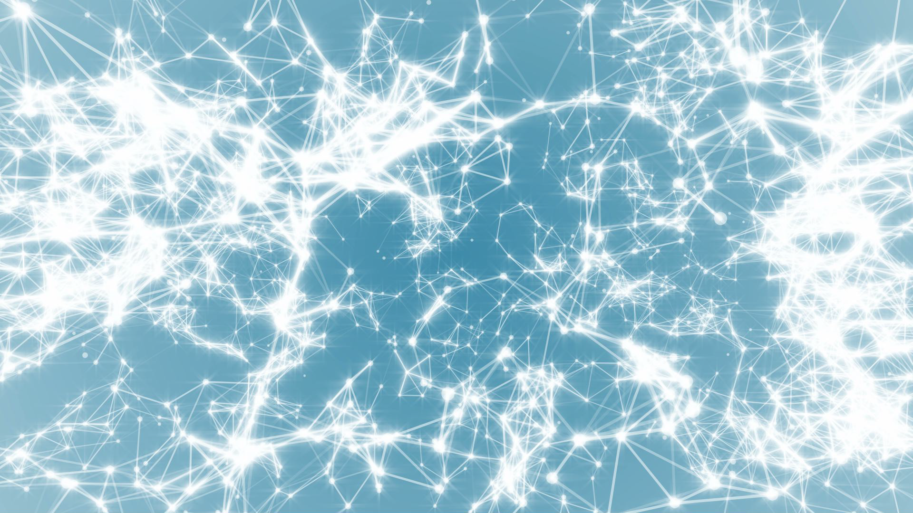
Frontiers of Network Science
Fall 2022
Class 2: Introduction Part II
(Chapter 1 in Textbook)
based on slides by
Albert-László Barabási
and Roberta Sinatra
Boleslaw Szymanski

Slide 2
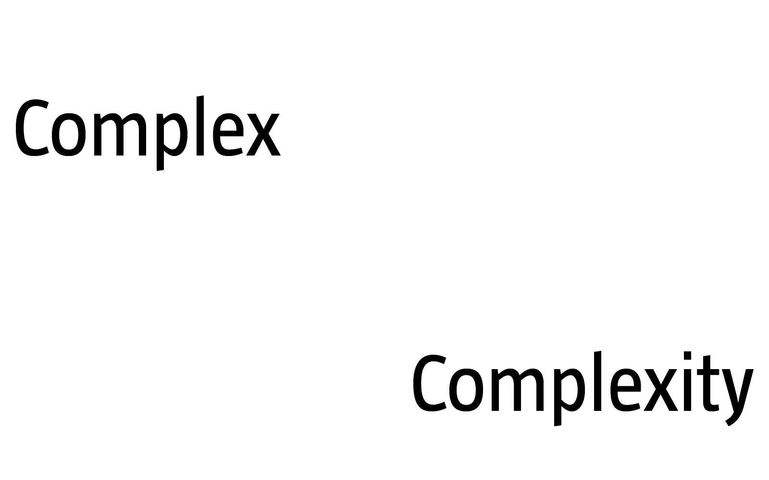
COMPLEX SYSTEMS
Complexity, a scientific theory which asserts that some systems display behavioral phenomena that are completely inexplicable by any conventional analysis of the systems’ constituent parts. These phenomena, commonly referred to as emergent behaviour, seem to occur in many complex systems involving living organisms, such as a stock market or the human brain.
Source: John L. Casti, Encyclopædia Britannica
[adj., v. kuh m-pleks, kom-pleks; n. kom-pleks]
–adjective
1.
composed of many interconnected parts; compound; composite: a complex highway system.
2.
characterized by a very complicated or involved arrangement of parts, units, etc.: complex machinery.
3.
so complicated or intricate as to be hard to understand or deal with: a complex problem.
Source: Dictionary.com
Network Science: Introduction
Notes:
We are surrounded by systems that are hopelessly complicated, from the society, whose seamless functioning requires cooperation between billions of individuals, to communications infrastructures that integrate billions of cell phones with computers and satellites. Our ability to reason and comprehend the world around us is guaranteed by the coherent activity of billions of neurons in our brain. Our very existence is rooted in seamless interactions between thousands of genes and metabolites with- in our cells. These systems are collectively called complex systems. Given the important role they play in our life, in science and economy, the understanding, mathematical description, prediction, and eventually the control of such complex systems is one of the major intellectual and scientific challenges of the 21st century.
The emergence of network theory, at the dawn of the 21st century is a vivid demonstration that science can live up to this challenge. Indeed, behind each complex system, there is an intricate network that encodes the interactions between the system’s components:

Slide 3
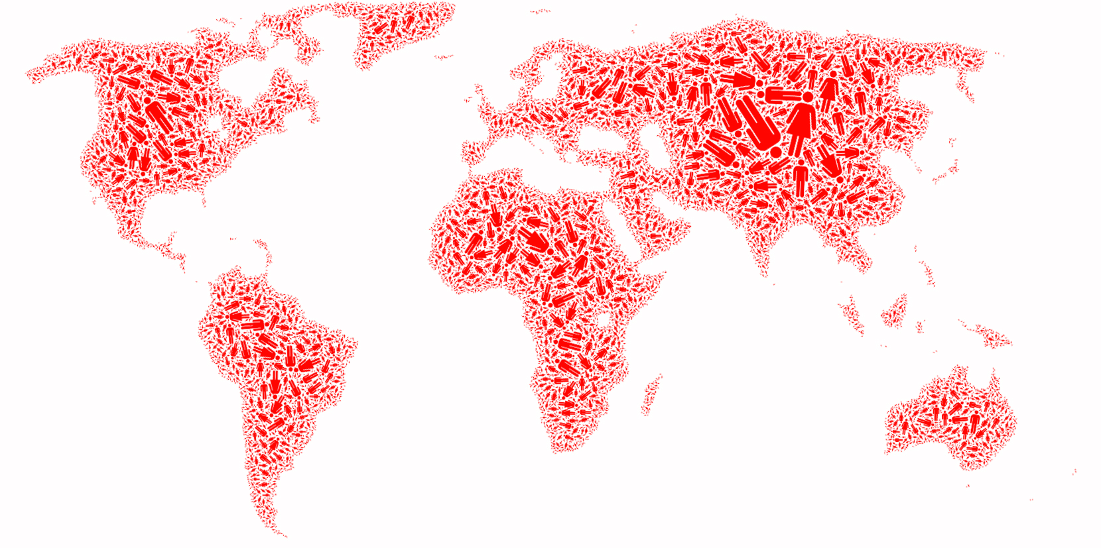
SOCIETY Factoid:
The "Day of 7 Billion" has been targeted by the United States Census Bureau to be in July 2012.
http://en.wikipedia.org/wiki/World_population
Network Science: Introduction
Notes:
The sum of all professional, friendship, and family ties is the fabric of the society.

Slide 4
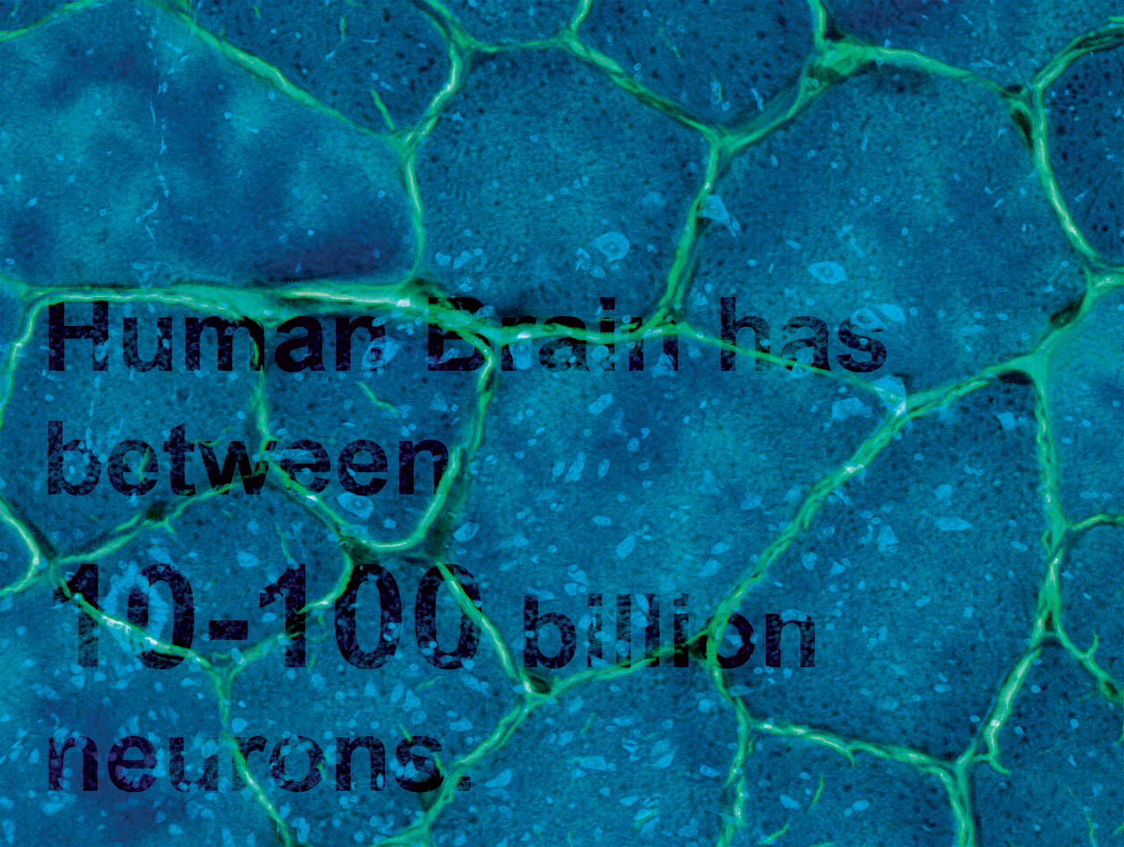
Brain
BRAIN Factoid:
Factoid:
Human Brain has between
10-100 billion neurons.
Network Science: Introduction
Notes:
The wiring diagram capturing the connections between neural cells holds the key to our understanding of brain functions.

Slide 5
ECONOMY Factoid:
The world economy produced goods and services worth almost $55 trillion in 2005.
(http://siteresources.worldbank.org/ICPINT/Resources/ICPreportprelim.pdf)
Network Science: Introduction

Slide 6
THE HUMAN CELL Factoid:
How Many Genes are in
the Human Genome?
http://www.ornl.gov/sci/techresources/Human_Genome/faq/genenumber.shtml
23,299
Network Science: Introduction
Notes:
The network describing the interactions between genes, proteins, and metabolites integrates the processes behind living cells.

Slide 7
THE ROLE OF NETWORKS
Behind each complex system there is a network, that defines the interactions between the components.
Network Science: Introduction

Slide 8
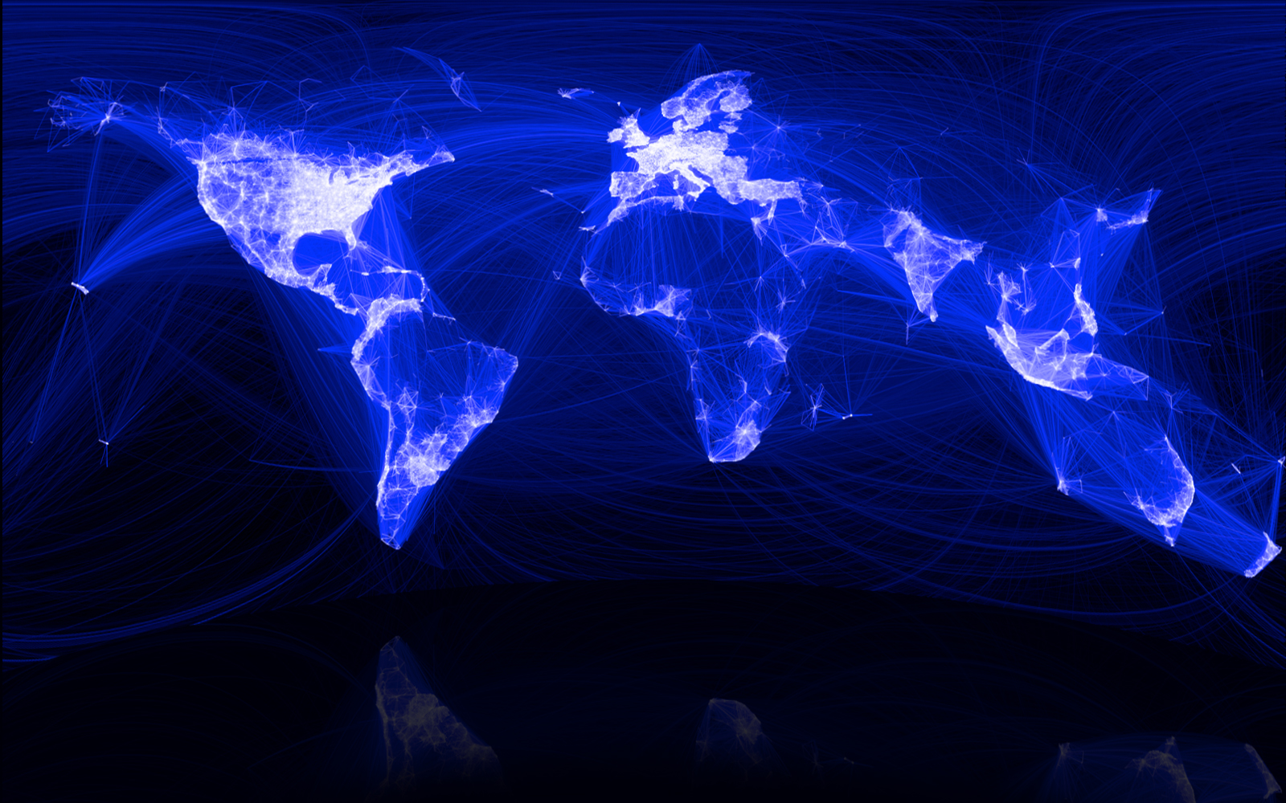
SOCIETY Factoid:
The “Social Graph” behind Facebook
Keith Shepherd's "Sunday Best”. http://baseballart.com/2010/07/shades-of-greatness-a-story-that-needed-to-be-told/
Network Science: Introduction
Notes:
The network describing the interactions between genes, proteins, and metabolites integrate the processes behind living streams. The wiring diagram capturing the connections between neural cells hold the key to our understanding of brain functions. The sum of all professional, friendship, and family ties is the fabric of the society. The network describing which communication devices interact with each other, capturing internet connections to wireless links, is the heart of the modern communication system. The power grid, a network of generators and transmission lines, supplies with energy virtually all modern technology. Trade networks maintain our ability to exchange goods and services, being responsible for the material prosperity that an increasing fraction of the world has enjoyed since WWII (Image 2). They also play a key role in the spread of financial and economics crises. Networks are at the heart of some of the most revolutionary technologies of the 21st century, empowering everything from Google to Facebook, CISCO, and Twitter. At the end, networks permeate science, technology, and nature to a much higher degree than may be evident upon a casual inspection. Consequently, we will never understand complex systems unless we gain a deep understanding of the networks behind them.While network science is a relatively young field, its roots go back several centuries. The scientific explosion of the field has experienced during the first decade of the 21st century is rooted in the discovery that despite the apparent differences, the emergence and evolution of rather different networks is driven by a common set of fundamental laws and reproducible mechanism. Hence despite amazing the diversity in form, size, nature, age, and scope present in real networks, most networks observed in nature, society, and technology are driven by common organizing principles. In other words once we disregard the nature of the components and their interactions, the obtained networks appear to be more similar than different from each other. In the following sections we discuss the forces that have led to the emergence of this new research field and its impact on science, technology, and society.

Slide 9
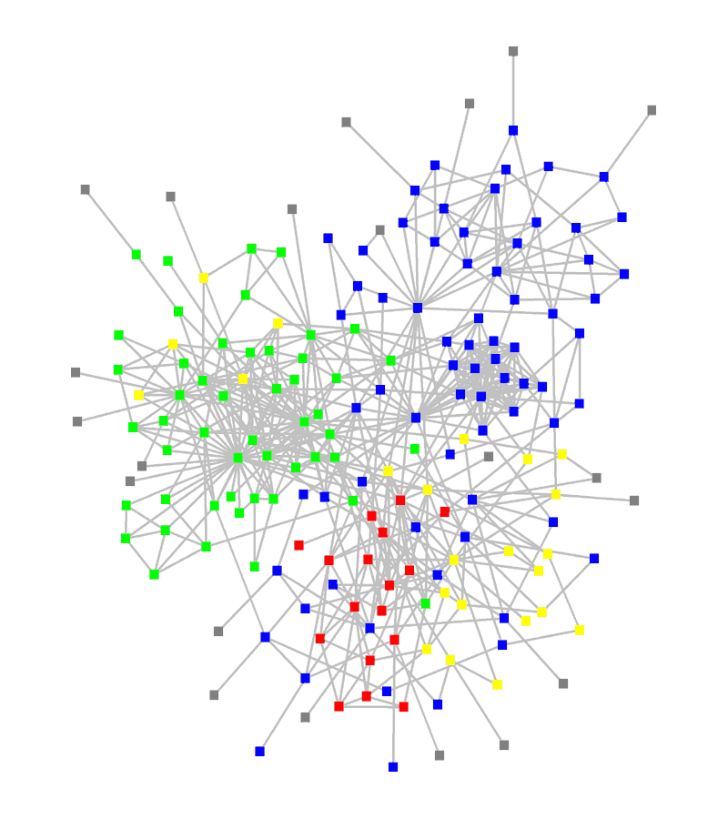
STRUCTURE OF AN ORGANIZATION
: departments
: consultants
: external experts
www.orgnet.com
Network Science: Introduction

Slide 10
The subtle financial networks
Network Science: Introduction
Notes:
{\bf The subtle networks behind the economy.}
A credit card, selected as the 99th object in the popular exhibition by the British Museum, entitled {\it The History of the World in 100 Objects.} This card demonstrates the interconnected nature of the modern economy, creating subtle linkages that one normally does not even think of. The card was issued in the United Arab Emirates in 2009 by the Hong Kong and Shanghai Banking Corporation, commonly known HSBC, a London based bank. The card functions through protocols provided by VISA, an USA based credit association. Yet, the card adheres to Islamic banking principles, which operates in accordance with Fiqhal-Muamalat (Islamic rules of transactions), most notably the elimination of interest or {\it riba}. The card is not limited to Muslims in the United Arab Emirates, but it is also offered to Muslim minorities in non-Muslim countries, and it is also used by many non-Muslims who agree with its strict ethical guidelines

Slide 11
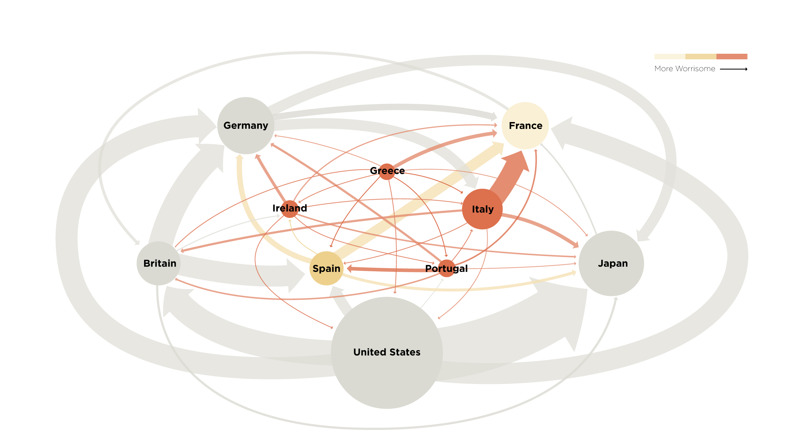
The not so subtle financial networks: 2011
Network Science: Introduction
Notes:
{\bf The subtle networks behind the economy.}

Slide 12
BUSINESS TIES IN US BIOTECH-INDUSTRY
Nodes:
Companies
Investment
Pharma
Research Labs
Public
Biotechnology
Links:
Collaborations
Financial
R&D
http://ecclectic.ss.uci.edu/~drwhite/Movie
Network Science: Introduction

Slide 13
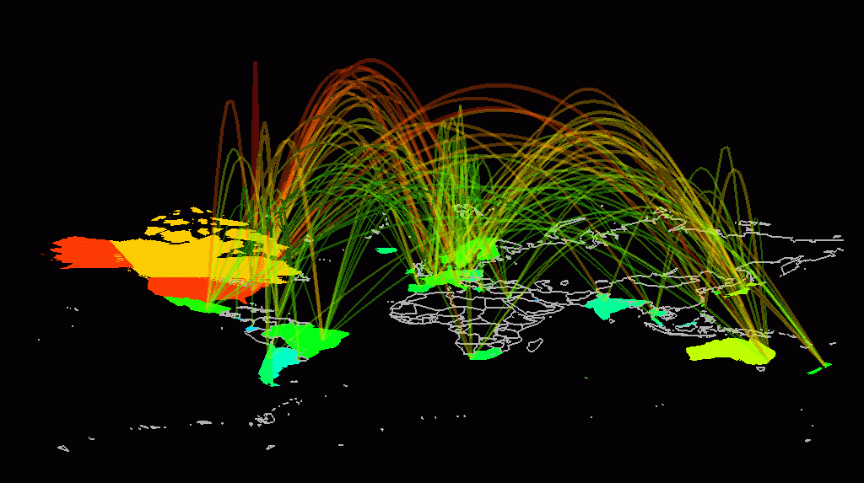
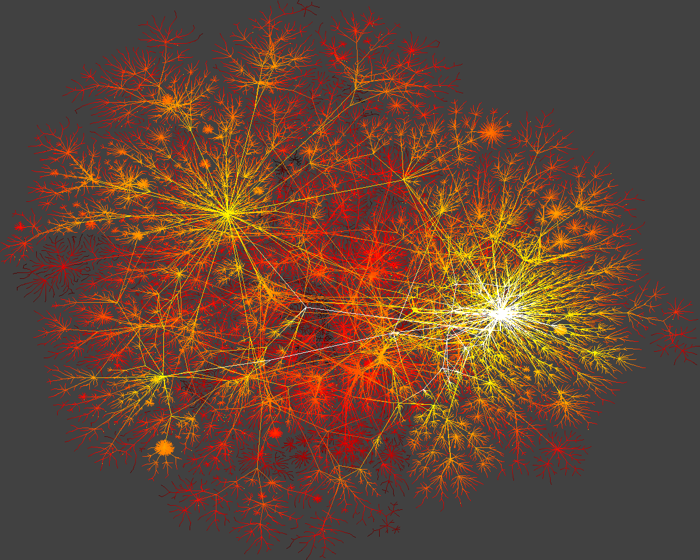
INTERNET
domain2
domain1
router
domain3
Network Science: Introduction

Slide 14
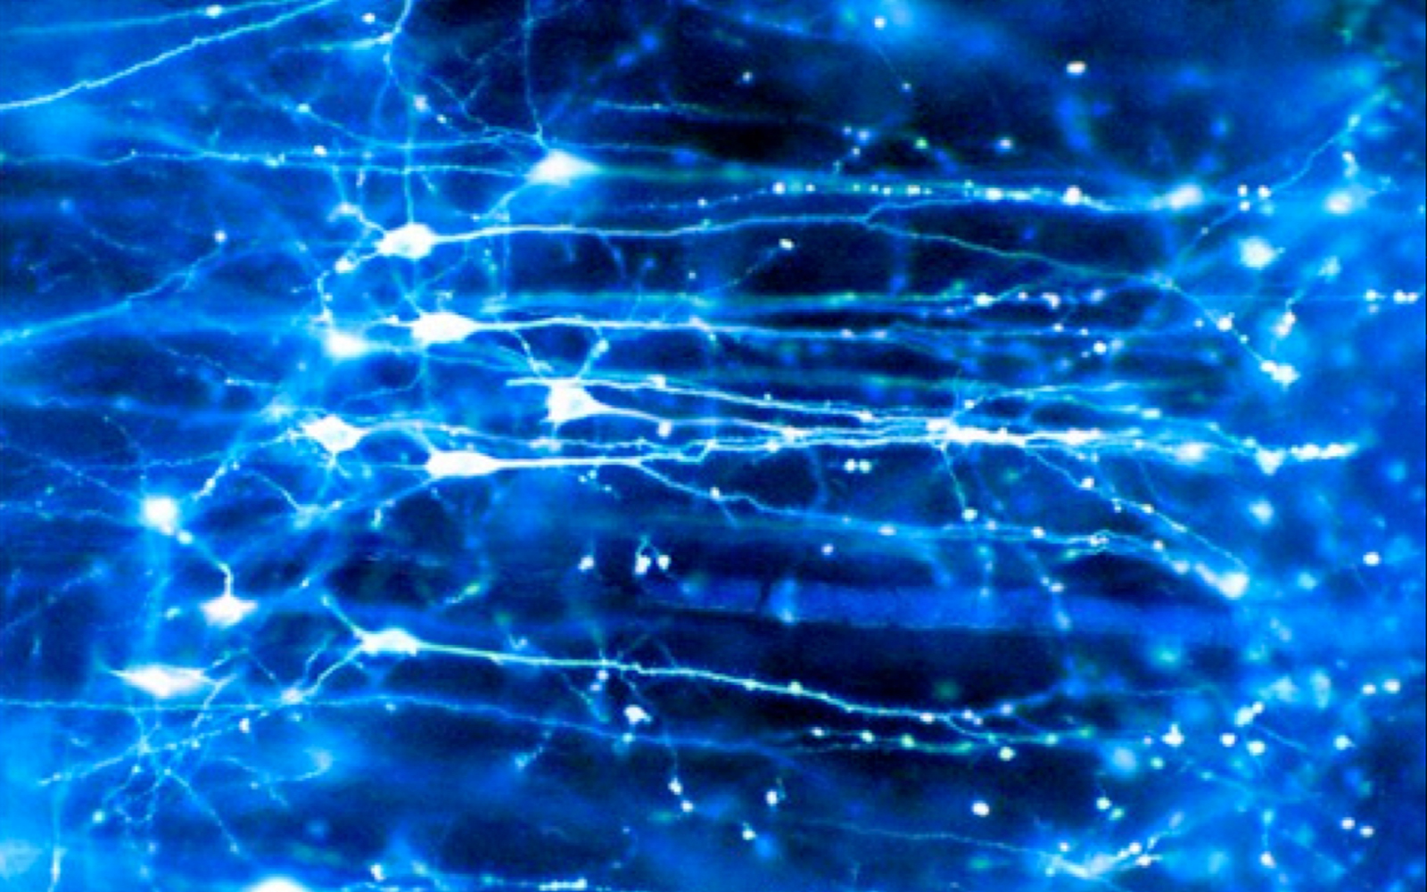
Brain
BRAIN Factoid:
Human Brain has between
10-100 billion neurons.
Network Science: Introduction
Notes:
We are surrounded by systems that are hopelessly complex, from the society, a collection of six billion individuals, to communications systems, that these days link billions of devices, from computers to cell phones. Our very existence is rooted in the ability of thousands of genes to work together in a seamless fashion; our thoughts, reasoning, and comprehension of the world is hidden in the connections between billions of neurons in our brain. These systems, random looking at first, upon close inspection display endless signatures of order and self-organization whose quantification, understanding, prediction and eventually control is the major intellectual challenge for the science of the 21st century

Slide 15
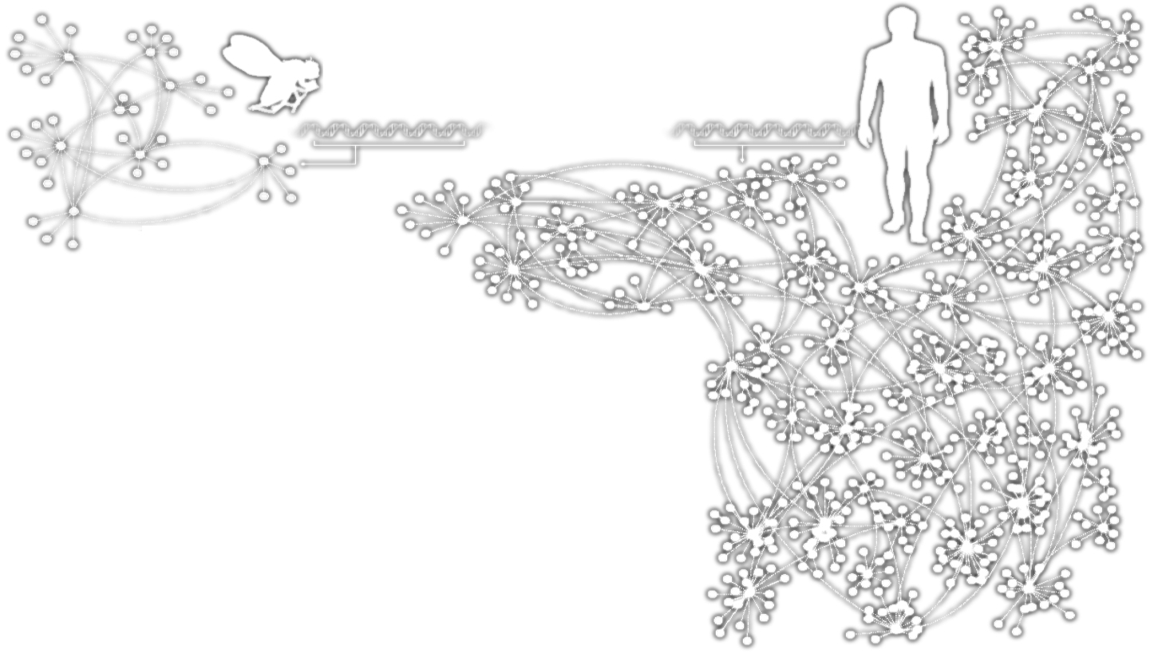
HUMANS GENES
Homo
Sapiens
Drosophila
Melanogaster
In the generic networks shown, the points represent the elements of each organism’s genetic network, and the dotted lines show the interactions between them.
Network Science: Introduction

Slide 16
HUMANS GENES
Homo
Sapiens
Drosophila
Melanogaster
Complex systems
Made of many non-identical elements connected by diverse interactions.
NETWORK
Network Science: Introduction

Slide 17
THE ROLE OF NETWORKS
Behind each system studied in complexity there is an intricate wiring diagram, or a network, that defines the interactions between the component.
We will never understand complex system unless we map out and understand the networks behind them.
Network Science: Introduction

Slide 18
Section 5
TWO FORCES HELPED THE EMERGENCE OF NETWORK SCIENCE
Network Science: Introduction

Slide 19
THE EMERGENCE OF NETWORK SCIENCE
The emergence of network maps:
Movie Actor Network, 1998;
World Wide Web, 1999.
C elegans neural wiring diagram 1990
Citation Network, 1998
Metabolic Network, 2000;
PPI network, 2001
Network Science: Introduction
Notes:
The emergence of network maps: To describe the behavior of a system consisting of hundreds to billions of interacting components, we first need a map of the system’s wiring diagram. In a social system, this would require knowing the list of your friends, your friends’ friends, and so on. In the WWW, this map tells us which webpages link to each other. In the cell, this corresponds to a detailed list of binding interactions and reactions that the genes, proteins, and metabolites participate in. In the past, we either lacked the tools to map these networks out, or it was difficult to keep track of the huge amount of data behind these maps. The emergence of the Internet, offering effective and fast data sharing methods, together with cheap digital storage, fundamentally changed this, allows us to collect, assemble, share, and analyze data pertaining to real networks.
While many of the canonical maps studied today in net- work science were not collected with the purpose of studying networks (Box 2):
The list of chemical reactions that take place in a cell were discovered over a 150 year period by biochemists and biologists. In the 1990s they were collected in central databases, offering the first chance to assemble the networks behind a cell.
The list of actors that play in each movie were traditionally scattered in books and encyclopedias. With the advent of the Internet, these disparate data were assembled into a central database by imdb.com, mainly to feed the curiosity of movie aficionados. The database offered the first chance for network scientists to explore the structure of the affiliation network behind Hollywood.
The detailed list of authors of millions of research papers were traditionally scattered in the table of content of thou- sands of journals, but recently the Web of Science, Google Scholar, and other sites assembled them into comprehensive databases, easing the search for scientific information.
We also witnessed an explosion of map making at the end of the 1990s. These offered detailed maps of the networks behind numerous complex system, from cell to the economy. Examples include the CAIDA or DIMES project aimed at obtaining an accurate map of the Internet [8]; the hundreds of millions of dollars spent by biologists to systematically map out protein-protein inter- actions in human cells [6], or the Connectome project of the US National Institute of Health that aims to trace the neural connection in mammalian brains [7].

Slide 20
THE EMERGENCE OF NETWORK SCIENCE
The universality of network characteristics:
The architecture of networks emerging in various domains of science, nature, and technology are more similar to each other than one would have expected.
Network Science: Introduction
Notes:
The universality of network characteristics: It is easy to list the differences between the various networks we encounter in nature or society: the nodes of the metabolic network are tiny molecules and the links are chemical reactions governed by quantum mechanics; the nodes of the WWW are web documents and the links are URLs maintained by computer algorithms; the nodes of the social network are individuals, the links representing family, professionals, friendship, and acquaintance ties.
The processes that shape these networks also differ greatly: metabolic networks are shaped by billions of years of evolution; WWW is collectively built by the actions of mil- lions of individuals; social networks are shaped by social norms whose roots go back thousands of years.
Given this diversity in size, nature, scope, history, and evolution, one would not be surprised if the networks behind these systems would differ greatly. Yet, a key discovery of network science is that the architecture and the evolution of net- works emerging in various domains of science, nature, and technology are rather similar to each other, allowing us to use a common set of mathematical tools to explore these systems.
This universality is one of the guiding principle of this book: we will not only seek to uncover specific network properties, but we will aim to understand its origins, en- coding the laws that shape network evolution, as well as its consequences in understanding network behavior.

Slide 21
THE EMERGENCE OF NETWORK SCIENCE
Data Availability:
C elegans neural wiring diagram 1990
Movie Actor Network, 1998
Citation Network, 1998
World Wide Web, 1999
Metabolic Network, 2000
PPI network, 2001
Universality:
The architecture of networks emerging in various domains of science, nature, and technology are more similar to each other than one would have expected.
The (urgent) need to understand complexity:
Despite the challenges complex systems offer us, we cannot afford to not address their behavior, a view increasingly shared both by scientists and policy makers. Networks are not only essential for this journey, but during the past decade some of the most important advances towards understanding complexity were provided in context of network theory.
Network Science: Introduction

Slide 22
THE HISTORY OF NETWORK ANALYSIS
Graph theory: 1735, Euler
Social Network Research: 1930s, Moreno
Communication networks/internet: 1960s
Ecological Networks: May, 1979.
Network Science: Introduction
Notes:
Why didn’t network science emerge two hundred years earlier? The networks it explores are by no means new: metabolic networks date back to the origins of life, with a history of four billion years, and the Internet is over four decades old. Furthermore, many disciplines, from bio- chemistry to sociology, and brain science, have been dealing with their notion of networks. Graph theory, a prolific subfield of mathematics, has focused on networks since 1735. Why do we dare to call network science the science of the 21st century?

Slide 23
THE TOOLS OF MODERN NETWORK THEORY
> Graph theory
> Social network theory
> Statistical physics
> Computer science
> Biology
> Statistics
Network Science: Introduction

Slide 24
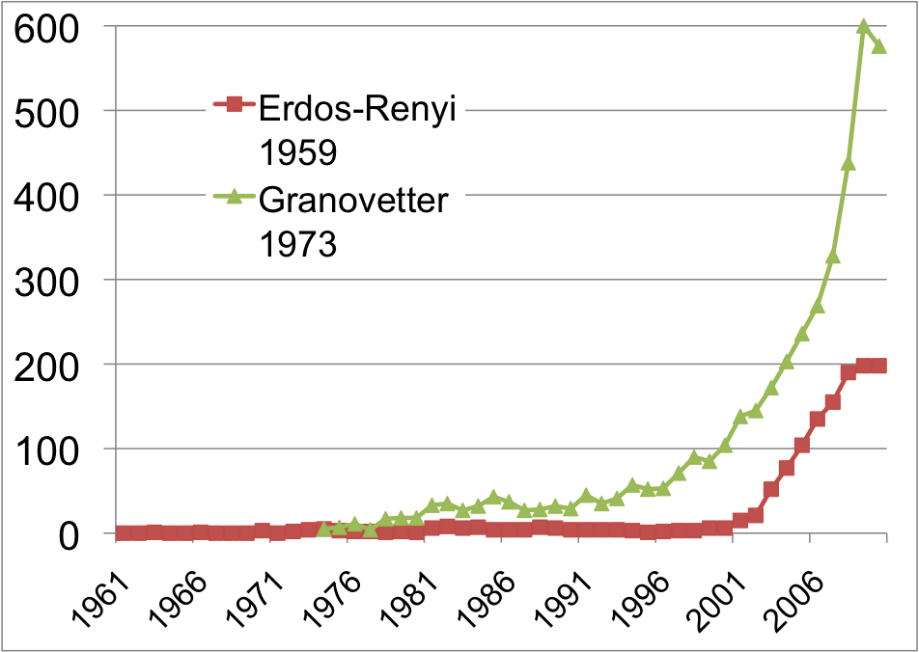
THE HISTORY OF NETWORK ANALYSIS
Network Science: Introduction
Notes:
Something special happened at the dawn of the 21st century that transcended individual research fields and catalyzed the emergence of a new discipline (Image 1.5). To understand why this happened only now, and not two hundred years earlier, we need to discuss the forces that have contributed to the emergence of network science.
While the study of networks has a long history from graph theory to sociology, the modern chapter of network science emerged only during the first decade of the 21st century, following the publication of two seminal papers in 1998 [2] and 1999 [3]. The explosive interest in network science is well documented by the citation pattern of two classic network papers, the 1959 paper by Paul Erdos and Alfréd Rényi that marks the beginning of the study of random networks in graph theory [4] and the 1973 paper by Mark Granovetter, the most cited social network paper [5]. Both papers were hardly or only moderately cited before 2000. The explosive growth of citations to these papers in the 21st century documents the emergence of network science, drawing a new, interdisciplinary audience to these classic publications.

Slide 25
Section 6
THE CHARACTERISTICS OF NETWORK SCIENCE
Network Science: Introduction
Notes:
Network science is distinguished, not only by its subject matter, but also by its methodology. In the following we briefly discuss the key characteristics of the approach network science adopted to understand complex systems, helping us better understand the domain we are about to embark on.

Slide 26
THE CHARACTERISTICS OF NETWORK SCIENCE
Interdisciplinary
Empirical
Quantitative and Mathematical
Computational
Network Science: Introduction
Notes:
Interdisciplinary nature: Network science offers a language through which different disciplines can seamlessly interact with each other. Indeed, cell biologists and computer scientists alike are faced with the task of characterizing the wiring diagram behind their system, extracting information from incomplete and noisy datasets, and the need to understand their systems’ robustness to failures or deliberate attacks.
To be sure, each discipline brings along a different set of technical details and challenges, which are important on their own. Yet, the common character of the many issues various fields struggle with have led to a cross-disciplinary fertilization of tools and ideas. For example, the concept of betweenness centrality that emerged in the social network literature in the 1970s, today plays a key role in identifying high traffic nodes on the Internet; algorithms developed by computer scientists for graph partitioning have found novel applications in cell biology.

Slide 27
THE CHARACTERISTICS OF NETWORK SCIENCE
Interdisciplinary
Empirical, data driven
Quantitative and Mathematical
Computational
Network Science: Introduction
Notes:
Empirical, data driven nature: The tools of network science have their roots in graph theory, a fertile field of mathematics. What distinguishes network science from graph theory is its empirical nature, i.e. its focus on data and utility. As we will see in the coming chapters, we will never be satisfied with developing the abstract mathematical tools to describe a certain network property. Each tool we develop will be tested on real data and its value will be judged by the insights it offers about a system’s structure or evolution.

Slide 28
THE CHARACTERISTICS OF NETWORK SCIENCE
Interdisciplinary
Empirical
Quantitative and Mathematical
Computational
Network Science: Introduction
Notes:
Quantitative and mathematical nature: To contribute to the development of network science, it is essential to master the mathematical tools behind it. The tools of network science borrowed the formalism to deal with graphs from graph theory and the conceptual framework to deal with randomness and seek universal organizing principles from statistical physics. Lately, the field is benefiting from concepts borrowed from engineering, control and information theory, statistics and data mining, helping us ex- tract information from incomplete and noisy datasets.

Slide 29
THE CHARACTERISTICS OF NETWORK SCIENCE
Interdisciplinary
Empirical
Quantitative and Mathematical
Computational
Network Science: Introduction
Notes:
Computational nature: Finally, given the size of many of the networks we explore, and the exceptional amount of data behind them, network science offers a series of formidable computational challenges. Hence, the field has a strong computational character, actively borrowing from algorithms, database management and data mining. A series of software tools help practitioners with diverse computational skills analyze networks.

Slide 30
Section 7
THE IMPACT OF NETWORK SCIENCE
Network Science: Introduction
Notes:
The impact of a new research field is measured both by its intellectual achievements as well as by the reach and the potential of its applications. While network science is a young field, its impact is everywhere around us, as we discuss below.

Slide 31
THE IMPACT OF NETWORK SCIENCE
Quantum Mechanics: 1900
-electron microscope 1931
-transistor 1947
-laser 1957
-magnetic resonance imaging 1973
-quantum computing 2015
Much of modern technology operates at a scale where quantum effects are significant.
At least a 30 year gap between the science and technology.
Network Science: Introduction

Slide 32
ECONOMIC IMPACT
Google
Market Cap(Jan 1, 2010):
$189 billion
Cisco Systems
networking gear Market cap (Jan 1, 2010):
$112 billion
Facebook
market cap:
$50 billion
www.bizjournals.com/austin/news/2010/11/15/facebooks... - Cached
Network Science: Introduction
Notes:
Economic Impact: From web search to social networking.
Some of the most successful companies of the 21st century, from Google to Facebook, Twitter, LinkedIn, Cisco to Apple and Akamai, base their technology and business model on networks. Indeed, Google is not only the biggest network mapping operation, building a comprehensive map of the WWW, but its search technology relies on the network characteristics of the Web.
Networks have gained particular popularity with the emergence of Facebook, the company with the oft-emphasized ambition to map out the social network of the whole planet. While Facebook was not the first social networking site, it is likely also not the last: an extensive ecosystem of social networking tools, from Twitter to Orkut, are attracting an impressive number of users (Image 1.6). The tools developed by network science fuel these sites, aiding everything from friend recommendation to advertising.

Slide 33
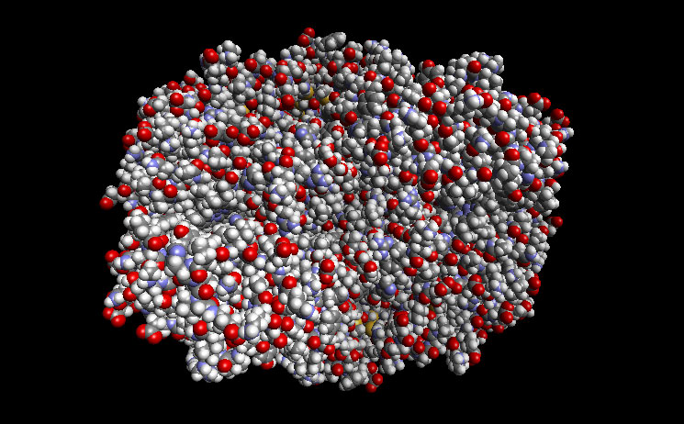
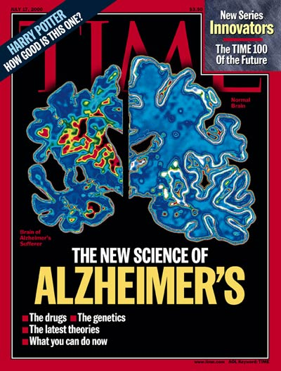
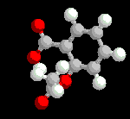
DRUG DESIGN, METABOLIC ENGINEERING:
Reduces
Inflammation
Fever
Pain
Prevents
Heart attack
Stroke
COX2
Causes
Bleeding
Ulcer
Reduces the risk of
Alzheimer's Disease
Reduces the risk of
breast cancer
ovarian cancers
colorectal cancer
Network Science: Introduction
Notes:
Health: From drug design to metabolic engineering.
The human genome project, completed in 2001, offered the first comprehensive list of all human genes. Yet, to fully understand how our cells function, and the origin of disease, we need accurate maps that tell us how these genes and other cellular components interact with each other. Most cellular processes, from the processing of food by our cells to sensing changes in the environment, rely on molecular networks. The breakdown of these networks is responsible for most human diseases. This has led to the emergence of network biology, a new subfield of biology that aims to understand the behavior of cellular networks. A parallel movement within medicine, called network medicine, aims to uncover the role of networks in human disease (Image 1.7a/b). Networks are particularly import- ant in drug development. The ultimate goal of network pharmacology is to develop drugs that can cure diseases without significant side effects. This goal is pursued at many levels, from millions of dollars invested to map out cellular networks to the development of tools and databas- es to store, curate, and analyze patient and genetic data. Several new companies take advantage of these opportuni- ties, from GeneGo that aims to collect accurate maps of celllular interactions from scientific literature to Genomatica that uses the predictive power behind metabolic networks to identify drug targets in bacteria and humans. Recently most major pharmaceutical companies have made significant investments in network and systems medicine, seeing it as the path towards future drugs.

Slide 34
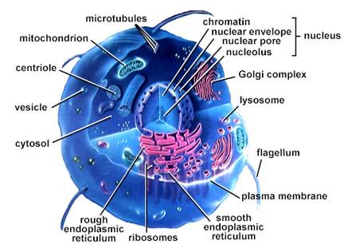
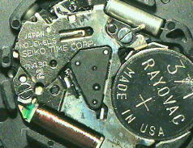
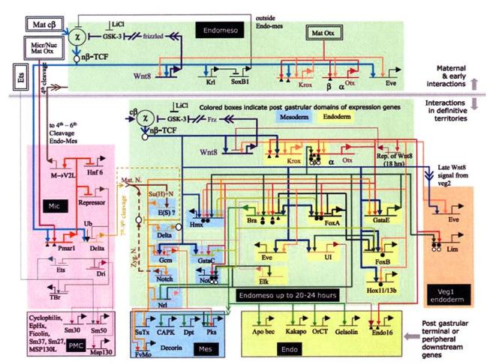
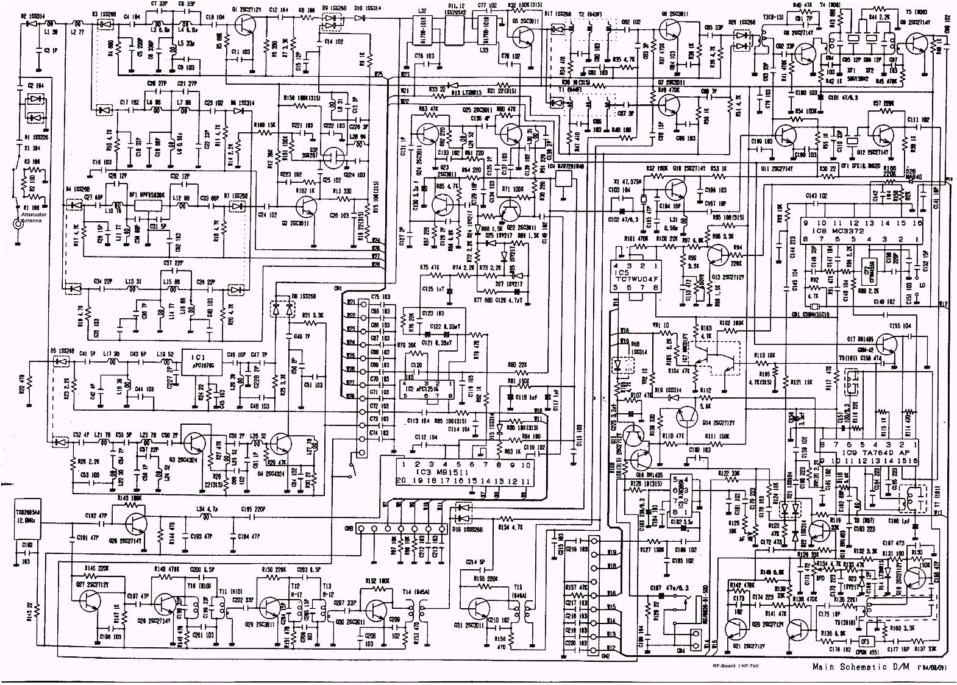
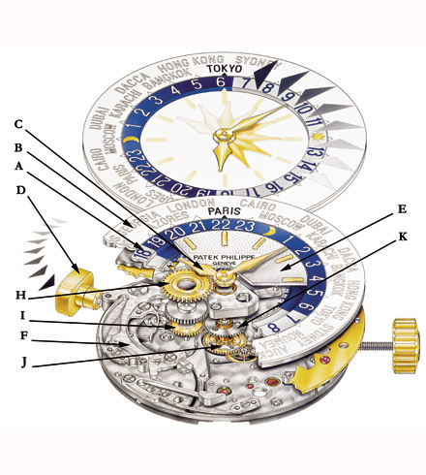
DRUG DESIGN, METABOLIC ENGINEERING:
Notes:
Health: From drug design to metabolic engineering.
The human genome project, completed in 2001, offered the first comprehensive list of all human genes [9, 10]. Yet, to fully understand how our cells function, and the origin of disease, we need accurate maps that tell us how these genes and other cellular components interact with each other. Most cellular processes, from the processing of food by our cells to sensing changes in the environment, rely on molecular networks. The breakdown of these networks is responsible for most human diseases. This has led to the emergence of network biology, a new subfield of biology that aims to understand the behavior of cellular networks. A parallel movement within medicine, called network medicine, aims to uncover the role of networks in human disease (Image 1.7a/b). Networks are particularly import- ant in drug development. The ultimate goal of network pharmacology is to develop drugs that can cure diseases without significant side effects. This goal is pursued at many levels, from millions of dollars invested to map out cellular networks to the development of tools and databases to store, curate, and analyze patient and genetic data. Several new companies take advantage of these opportunities, from GeneGo that aims to collect accurate maps of cellular interactions from scientific literature to Genomatica that uses the predictive power behind metabolic networks to identify drug targets in bacteria and humans. Recently most major pharmaceutical companies have made significant investments in network and systems medicine, seeing it as the path towards future drugs.

